Slide 1
Vaccination Visualization Project

Slide 2



vaccination trends using
Python
MySQL
PowerBI

Slide 3
Introduction
Vaccination plays a crucial role in global health, preventing diseases and reducing outbreaks. This project aims to analyze vaccination trends using Python and MySQL, helping to understand coverage rates, incidence rates, and the impact of vaccine introductions.
We focus on:
✅ Cleaning and processing vaccination data
✅ Visualizing trends in coverage and incidence rates
✅ Storing and managing data in MySQL for efficient analysis
✅ Enhancing insights using Power BI

Slide 4
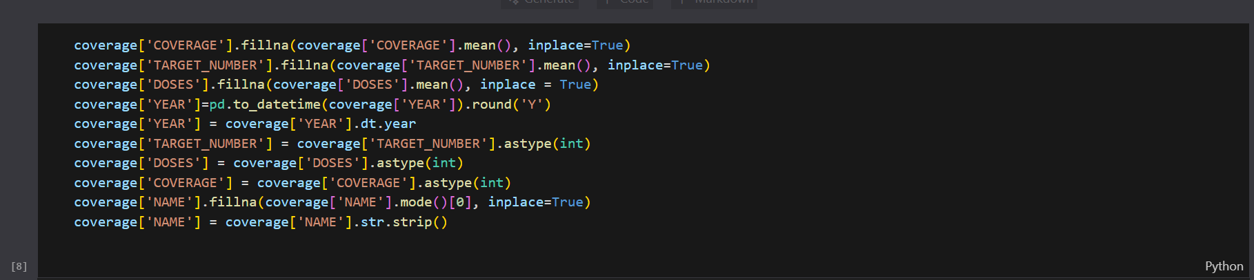
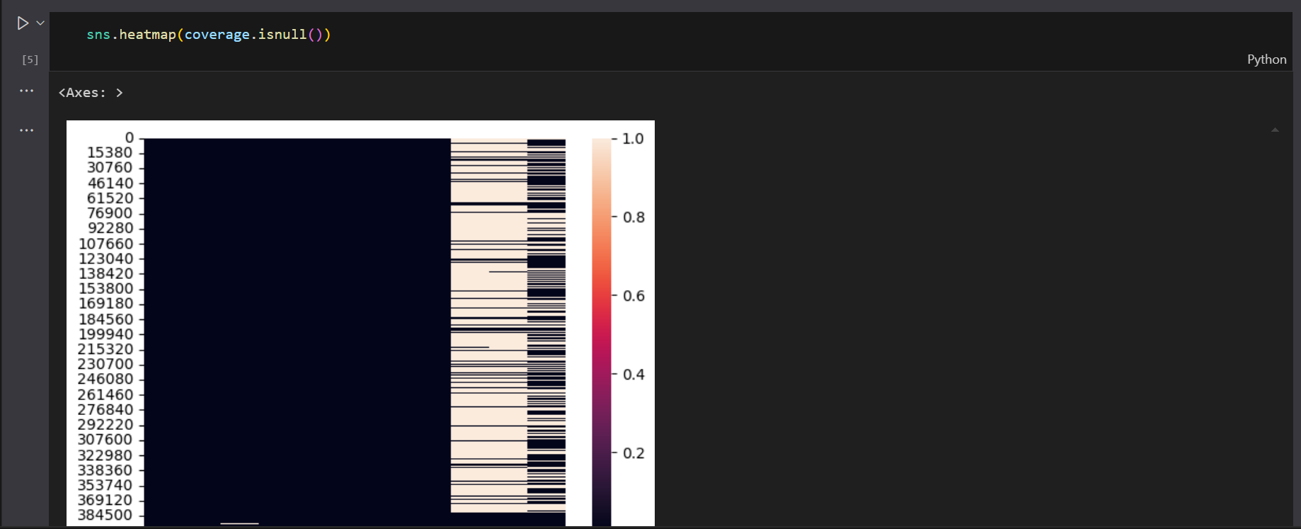
Data Sources & Processing:

Slide 5
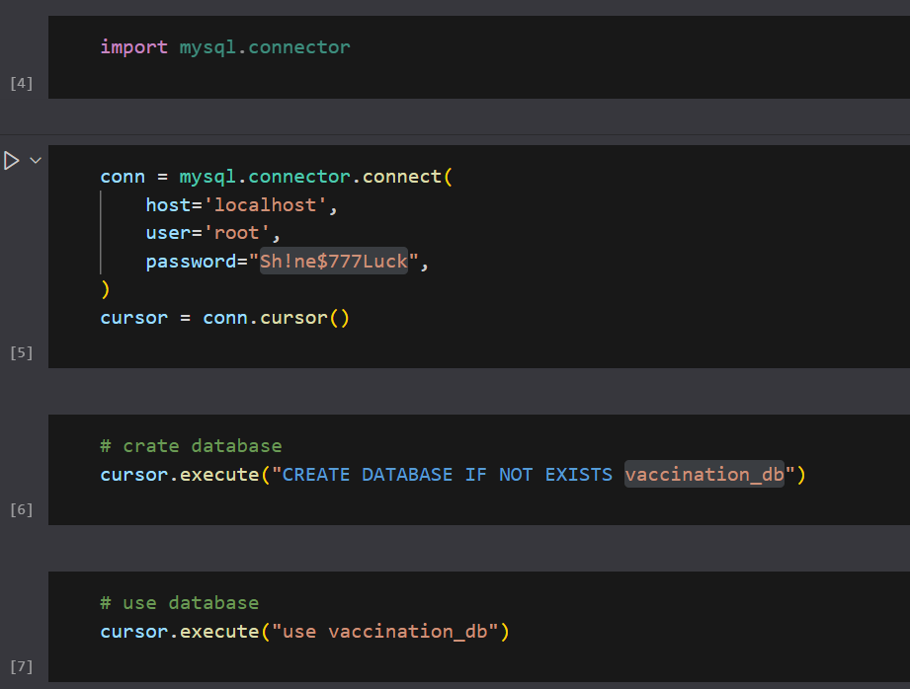
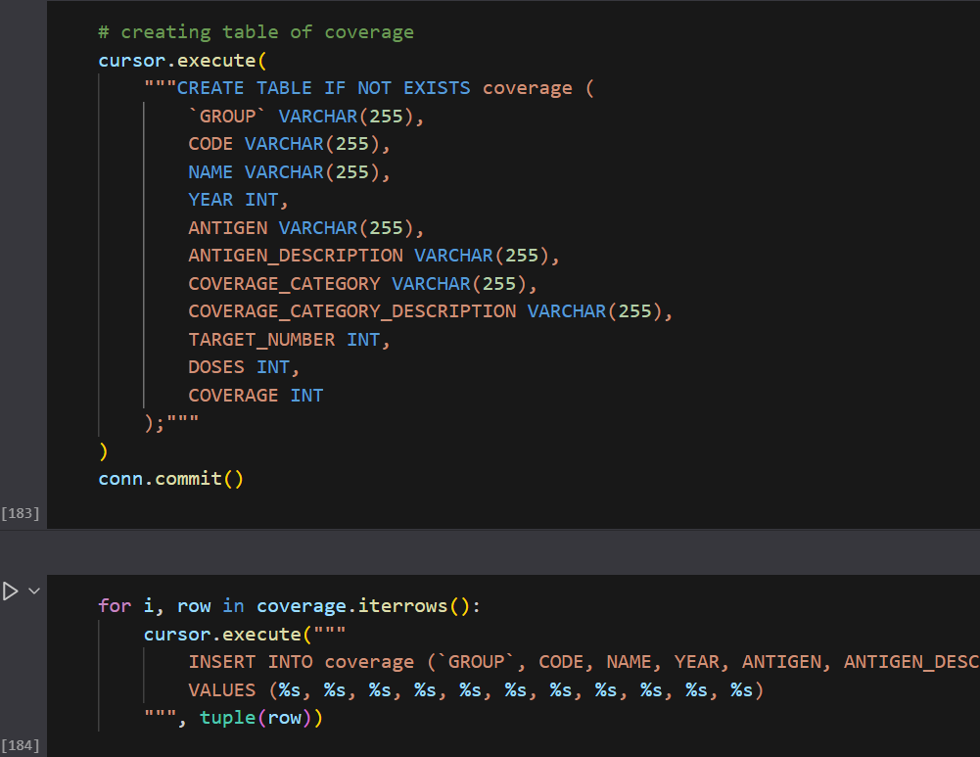
Database Management:

Slide 6
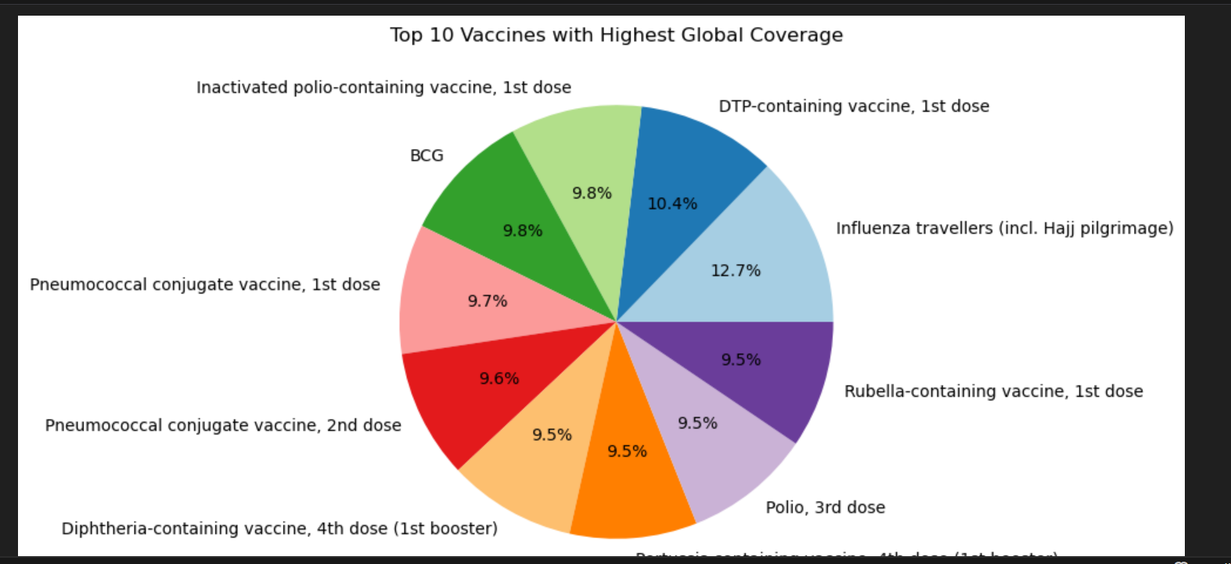
Coverage & Analysis:

Slide 7
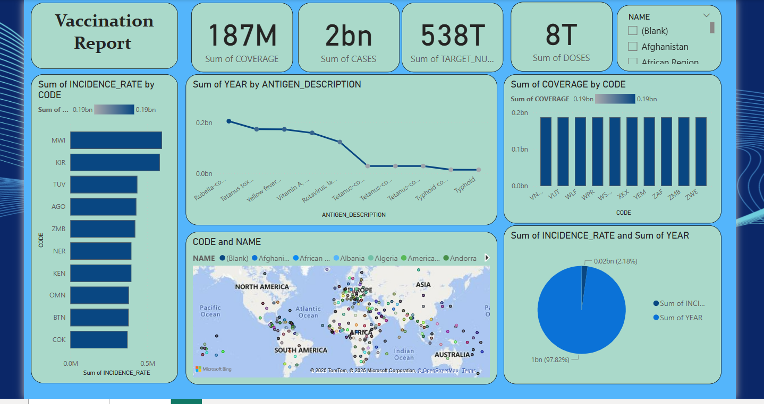
Power BI Integration

Slide 8
Questions
A government health agency wants to identify regions with low vaccination coverage to allocate resources effectively.
A public health organization wants to evaluate the effectiveness of a measles vaccination campaign launched five years ago.
A vaccine manufacturer wants to estimate vaccine demand for a specific disease in the upcoming year.
A non-profit wants to detect disparities in vaccination coverage across different socioeconomic groups within a country.
WHO wants to track global progress toward achieving a target of 95% vaccination coverage for measles by 2030.
Two regions use different vaccination strategies (e.g., door-to-door vs. centralized vaccination clinics). Authorities want to know which strategy is more effective.

Slide 9
Conclusion & Insights:
🔹 Summary of Findings:
Vaccination coverage has shown significant trends over the past decade.
WHO regions exhibit varying coverage rates, highlighting disparities in immunization efforts.
Newly introduced vaccines contribute to population coverage, impacting overall health outcomes.
🔹 Potential Applications of the Analysis:
Supporting health organizations in strategizing vaccination programs.
Identifying regions that require increased vaccination awareness and resources.
Enhancing predictive models for future vaccine distribution and effectiveness.
Leveraging Power BI for dynamic visual storytelling and reporting.

